Slide 1
Miles elementary FY26 Budget Feedback Meeting

Slide 2
AGENDA
Action Items (add items as needed)
Approval of Agenda
Approval of Previous Minutes
Discussion Items (add items as needed)
Budget Development Presentation
ACTION ITEM: GO Team vote on Draft Budget (AFTER presentation and discussion)
Discussion Item 2: [add description of the item]
Information Items (add items as needed)
Principal’s Report
Committee Reports (as needed)
Cluster Advisory Report (if CAT has met since last meeting)
Announcements (add items as needed)
Public Comment (if applicable)

Slide 3
Meeting Norms
This is a meeting of the GO Team. Only members of the team may participate in the discussion. Any members of the public present are here to quietly observe.
We will follow the agenda as noticed to the public and stay on task.
We invite and welcome contributions of every member and listen to each other.
We will respect all ideas and assume good intentions.

Slide 4
Budget Feedback presentation & Discussion

Slide 5
GO Team Budget Development Process
YOUR SCHOOL STRATEGIC PLAN…
is your roadmap and your role.
It is your direction, your priorities, your vision, your present, your future.
Step 1: Data Review
Step 2: Strategic Plan Review
Step 3: Budget Parameters
(Strategic Priorities)
Step 4: Budget Choices

Slide 6
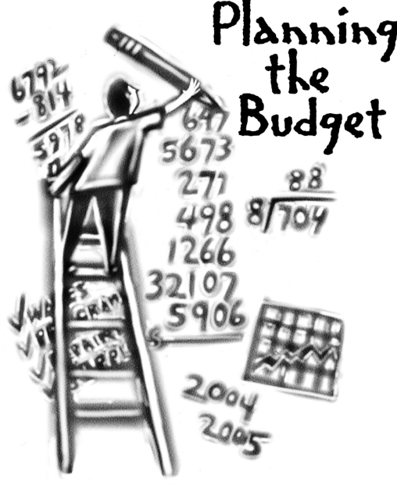
Overview of FY26 GO Team Budget Process
Step 2 Principals Workshop FY 26 Budget
January 15
Step 4 Principals Cluster Supt. Discussions
Step 1 Update Strategic Plan & Rank Priorities
Step 7 Principals HR Staffing Conferences Begin
Feb. 24-27
Step 3 GO Team Initial Budget Session
January 15-31
Step 8* GO Team Final Budget Approval Meeting
Budgets Approved by March 14
Step 6 Cluster Supt. Review February 17-21
Step 5* GO Team Feedback Mtg. February 10-14
GO Teams are encouraged to have ongoing conversations
* GO Teams will need to take ACTION on the budget at these meetings.

Slide 7
Budget Feedback Meeting
What
During the GO Team Feedback meeting the principal will share the 25-26 Strategic Plan Breakout, provide an overview of the school’s draft budget, share updated tabs from the Excel template, and review/collaborate with the GO Team on the comments/notes to explain the use of school-level flexibility in budget allocations.
Why
This meeting provides an opportunity for GO Teams to discuss the principal’s proposed budget and how it supports the school's programmatic needs and key strategic priorities for the 25-26 school year. It also provides the GO Team the opportunity to review and provide feedback on proposed use of school-level flexibility.
When
Early February 10 - February 14th, before Cluster Superintendent review.

Slide 8
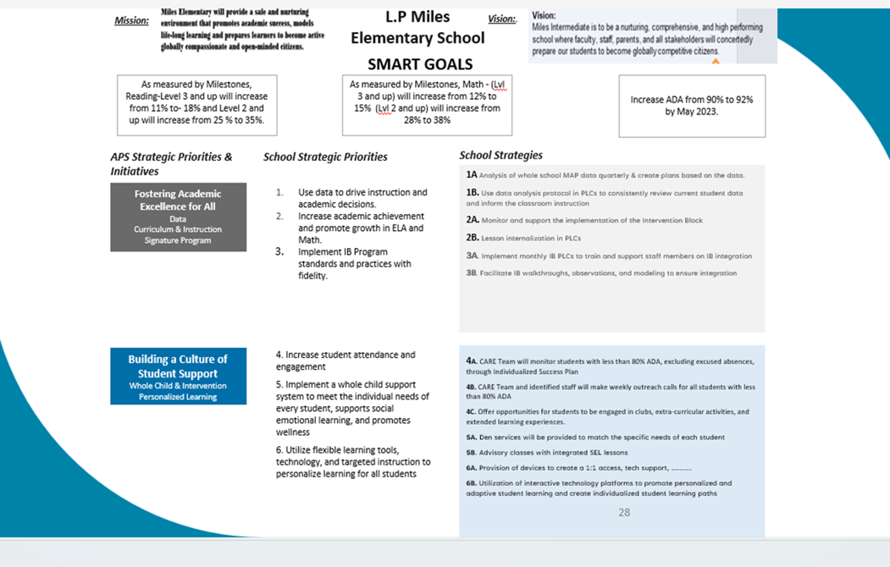
Miles elementary’s Strategic Plan

Slide 9
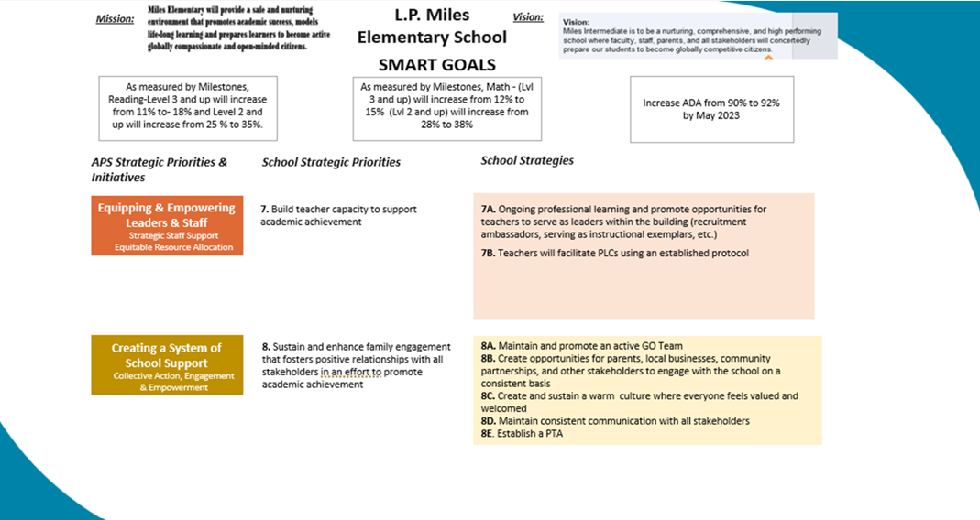
Miles Strategic Plan Continued

Slide 10
Miles Elem’s Strategic Plan
Priority Ranking
Insert the school’s ranked priorities from High to Low
Higher
Lower

Slide 11
FY 26 Budget Parameters
FY26 Ranked School Priorities | Rationale
Increase academic achievement and promote growth in ELA and Math by using data to drive instruction and academic decisions for our Sped Sub groups | Per our data, students in our Sped subgroup need maximized opportunities for achievement and remediation daily so that their individual academic needs are met
Implement IB program standards and practices with fidelity | IB is the signature program for the Mays Cluster and will ensure that students experience rigorous, quality academic programming.
Build teacher capacity to support academic achievement. | Use student data to provide professional development for teachers.

Slide 12
Review of FY26 Signature and Turnaround Program Funding Process
Overview
* The district is piloting a zero-based budgeting (ZBB) process for Signature and Turnaround Program Funds this year.
* Zero-based budgeting (ZBB) is a budgeting process that allocates funding based on program efficiency and necessity rather than budget history. As opposed to traditional budgeting, no item is automatically included in the next budget.
* As such the initial allocation for these programs at all schools will be $0.
Process
* Principals will develop proposed requests for the personnel and non-personnel they need to support the Signature and/or Turnaround Programs at their schools.
* Principals will share and discuss their proposals and rationale for the proposals with their school GO Team for feedback.
* After discussing with their GO Team, principals will submit their request for review by January 31st. Funding for these programs will be provided the week of February 3rd.

Slide 13
Overview of Approved Signature Program Funds

Slide 14
Signature program funds requested vs. approved
Requested Signature Program Funds: $275, 155
PRINCIPALS: Please update with the list of what you requested to support your signature program. Example: Signature Program Band Teacher Signature Program IB Coach Signature Program World Languages Teacher S
APPROVED Signature Program Funds: $275, 155
PRINCIPALS: Please update with the Staffing and Non-Staffing allocation of your updated Signature Program funds. Signature Program Band Teacher Sugnature Program IB Coach Signature World Languages Teacher

Slide 15
Overview of Approved turnaround Funds (if applicable. Remove this portion if you did not receive turnaround funds)

Slide 16
Approved FY26 Turnaround Funds

Slide 17
Miles Elementary FY26 Summary of Proposed Staffing AND Non-Staffing
-

Slide 18
Summary Tab Overview
The Summary Tab provides a summary of the staff in our school. The columns show how many positions are:
Earned – positions allocated by district departments. There is no school-level flexibility with these positions.
Funded – District’s recommended staffing for positions where there is school-level flexibility with staffing the position.
Staffed – This shows how the principal plans to staff the position for the FY26 school year.
Difference—This shows the difference between the recommendation from the District and the Principal's proposed FY26 staffing plan.
Comments: The principal must provide comments if there is a difference in what is Funded and Staffed. Principals and GO Teams will discuss the rationale provided for the Comments section.

Slide 22
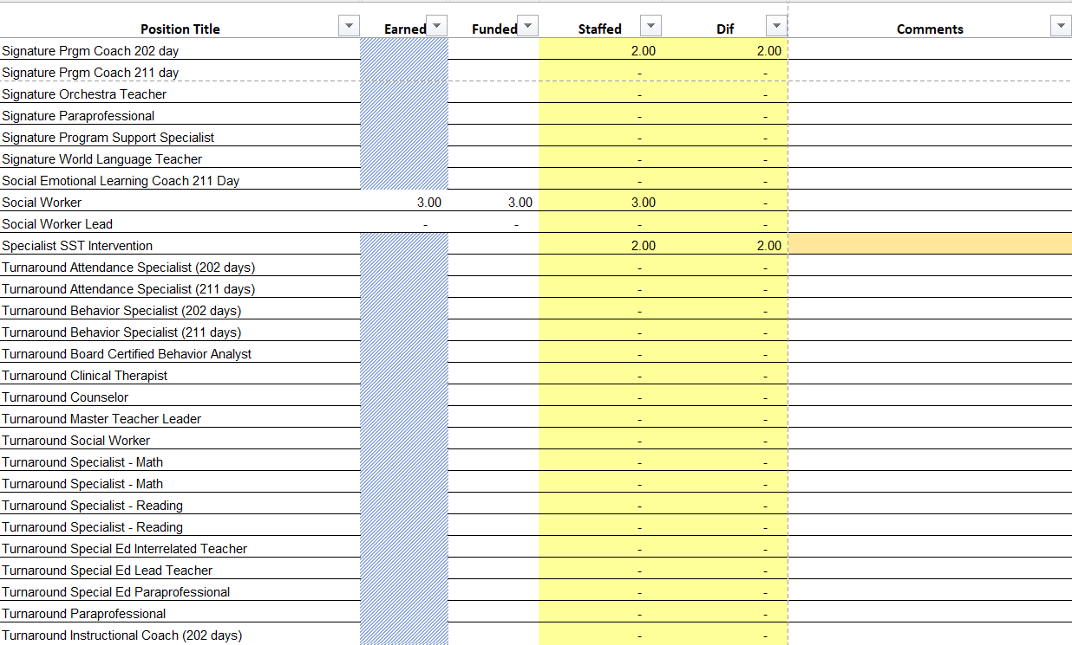
Example: Update with your school's Summary Tab- Use as many slides as needed. Please make sure the information on these slides reflects what you plan to send to your Cluster Supt. And your Staffing Conference

Slide 23
Example: Update with your school's Summary Tab- Use as many slides as needed. Please make sure the information on these slides reflects what you plan to send to your Cluster Supt. And your Staffing Conference

Slide 24
Summary of position Changes to Support the fy26 bUDGET
CREATED | REMOVED
 | 1 kindergarten teacher
 | 1 first grade teacher
 | 1 writing teacher
Summary of Changes
PRINCIPALS: due to the number of students enrolled we will no longer need 4 teachers for kindergarten and 1st grade. We reviewed data and did not see the benefit of the writing lab

Slide 25
Non-Staffing Tab Overview
The Non-Staffing Tab shows how funds are allocated for non-staff items in the school. There is school-level flexibility for most of these items. The tab has columns for:
Recommended—District’s recommended amount to spend on the line item.
Allocation – This shows how much the principal is proposing to allocate towards the line item in FY26.
Difference—This shows the difference between the recommended amount and the allocation.
Notes: The principal must provide comments if there is a difference in what is Recommended and what is Allocated. Principals and GO Teams will discuss the rationale for the notes section.

Slide 27
Descriptions of Strategic Plan Breakout Categories
Priorities: FY25 funding priorities from the school’s strategic plan, ranked by the order of importance.
Strategies: Lays out specific objectives for school’s improvement.
Request: “The Ask” What needs to be funded in order to support the strategy?
Amount: What is the cost associated with the Request?

Slide 28
FY26 Strategic Plan Break-out
Priorities | Strategies | Requests | Amount
Increase level of rigor and relevance (example- please remove) | Implementation of guided reading training for all staff (example- please remove) | Instructional coach | $84, 134 (example- please remove)
Implement IB program standards and practices with fidelity | Provides Spanish for students to meet IB requirements and standards of service. | World languages teacher | 127, 566
SEL and Whole Child | Provides de-escalation strategies | Clinical therapist | 141, 098
Implement IB program standards and practices with fidelity | Train teachers on inquiry based learning and provide students with real life connections around the world | IB Signature Coach | 147, 559
Build teacher capacity to support academic achievement. | Provide reading strategies for teachers and students | Reading Specialist | 147,559

Slide 29
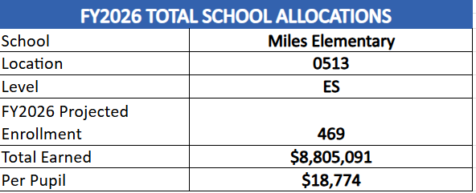
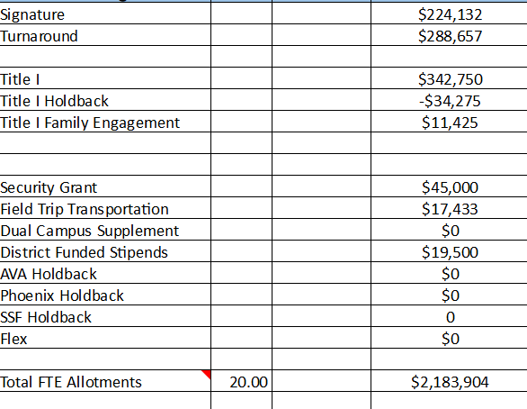
FY26 Budget by Function (required)
* Based on Current Allocation of School Budget

Slide 30
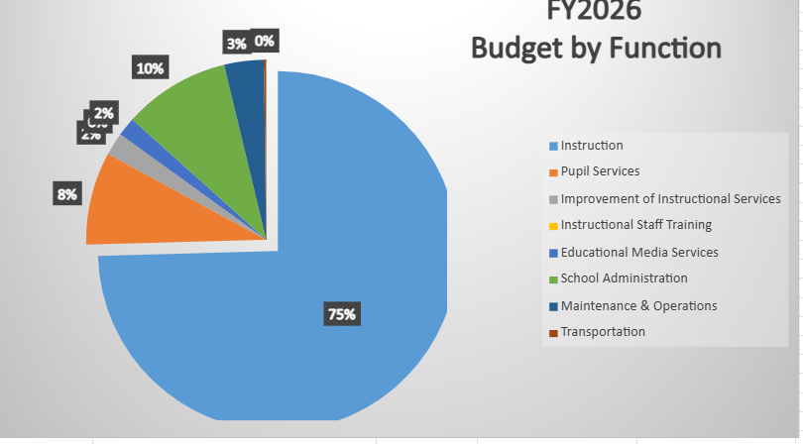
FY26 Budget by Function (required)
* Based on Current Allocation of School Budget

Slide 31
Questions for the GO Team to Consider and Discuss
Strategic Alignment and School-Level Flexibility
Does this budget proposal, as a whole, effectively support our school's strategic priorities?
How do the principal’s proposed changes directly support priorities in our strategic plan? Can we clearly connect each adjustment to a strategic goal?
If new positions, resources, or programs are being added, what data or feedback supports these changes? How will we measure their impact?
What trade-offs are involved? Are any current programs or resources being adjusted or reduced, and how will that affect our students and staff?

Slide 32
Questions for the GO Team to Consider and Discuss
District and Cluster Priorities
How do these proposed changes align with district and cluster priorities? Do we foresee any challenges or misalignments?
If the district has allocated funds for specific initiatives – for example Signature Programs - how are those reflected in our budget?
If we are sharing staff positions (e.g., nurse, counselor, teacher), how will this affect student support and service delivery at our school?

Slide 33
Discussion of Reserve & Holdback Funds

Slide 34
Plan for FY26 Leveling Reserve
$___114, 131___
Priorities | Strategies | Requests | Amount
Increase level of rigor and relevance (example- please remove) | Implementation of guided reading training for all staff (example- please remove) | Purchase an additional Teacher (example- please remove) | $84, 134 (example- please remove)
 | Create an intervention lab for students in 3rd -5th grades to improve reading and math proficiency | Purchase an additional teacher | 114, 131

Slide 35
Plan for FY26 Title I Holdback
$__-34,275____
Priorities | Strategies | Requests | Amount
Increase level of rigor and relevance (example- please remove) | Implementation of guided reading training for all staff (example- please remove) | Purchase an additional Teacher (example- please remove) | $84, 134 (example- please remove)

Slide 36
Action on the FY26 Draft Budget
The GO Team needs to TAKE ACTION (vote) on its draft FY26 budget.
After the motion and a second, the GO Team may have additional discussion.
Once discussion is concluded, the GO Team will vote.

Slide 37
Where We’re Going
Our next meeting is the Budget Approval Meeting
What:
During this meeting we will review the budget, which should be updated based on feedback from the staffing conference, Associate Superintendents, and key leaders. After review, GO Teams will need to take action (i.e., vote) on the FY26 Budget.
Why:
Principals will present the final budget recommendations for GO Team approval.
When:
All approval meetings must be held after staffing conferences. Budgets must be approved by March 14th.

Slide 38
What’s Next?
February
Cluster Superintendent Review (February 17-21)
HR Staffing Conferences (February 24– February 27)
March
Final GO Team Approval Meeting (AFTER your school’s Staffing Conference and BEFORE Friday, March 14th)
ACTION (i.e.- GO Team votes) on final budget recommendation before March 14

Slide 39
declare by February 28!
tinyAPS.com/?2025GOTeamDeclaration

Slide 40
Thank you!

Slide 41
Will be updated As soon as possible

